Slide 1

Creational Pattern:
Factory Pattern
00

Slide 2

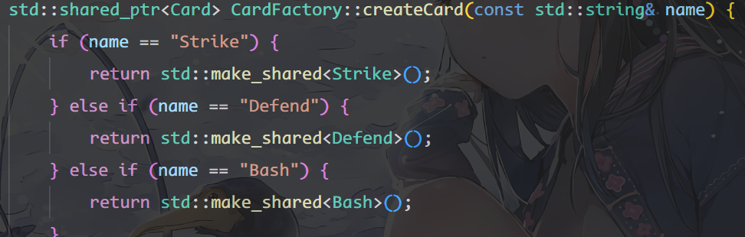
Creational Pattern: Factory Pattern
Card Creation System Refactoring
Before
Overview
Eliminates the need for a central "switch-case" factory by using Self-Registering Factory
Issue Before Refactoring
1. Violation of Open/Closed Principle (OCP): The factory class grows indefinitely as new content is added.
2. High Coupling: Any change might trigger a recompilation of all clients.
3. Maintenance Nightmare: Logic is prone to errors (typos in string matching inside the huge if-else block).

Slide 3
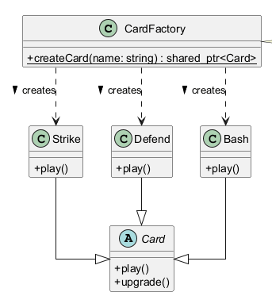
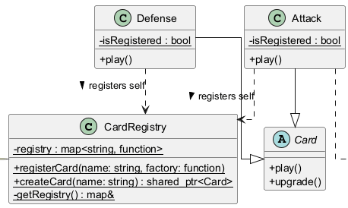
Creational Pattern: Factory Pattern
UML Changes
After
Before
Refactor Overview
1. Decoupled Architecture: Replaced the monolithic "switch-case" factory with a dynamic Registry Map
2. Auto-Registration: Implemented a macro-based system where new cards automatically register themselves at startup

Slide 4
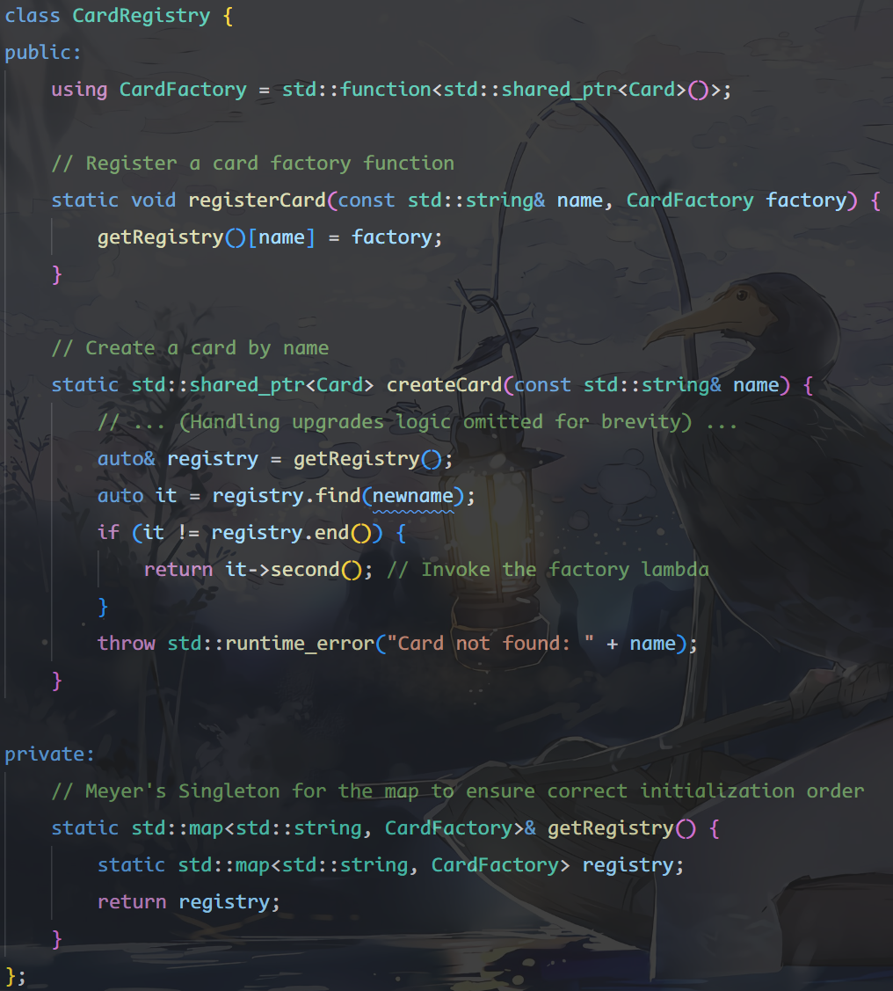
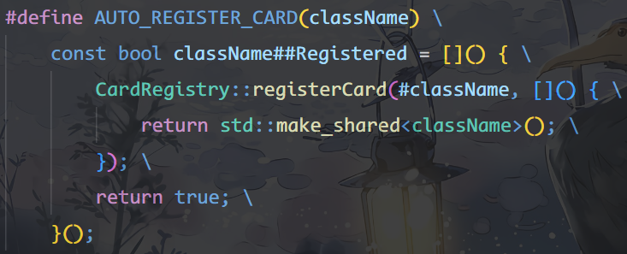
Creational Pattern: Factory Pattern
Detailed implementation
1. The Registry
2. The Registration Macro

Slide 5
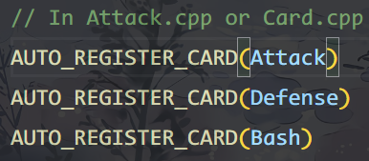
Creational Pattern: Factory Pattern
Advantages
Future Extensions
1 OCP Compliance
Add new cards without ever modifying the existing factory code.
2 Decoupling
Factory has zero compile-time dependencies on concrete card classes.
3 Zero Conflicts
Eliminates merge conflicts by removing the central "switch-case" file.
4 Ease of Extension
Developers simply add one macro line to register new content.
Adding a new card now requires 0 changes to the Factory or Registry. You simply add the macro in your implementation file.

